Slide 1
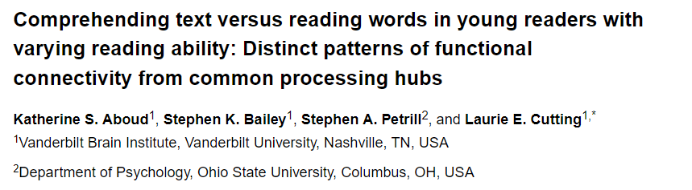

Slide 2
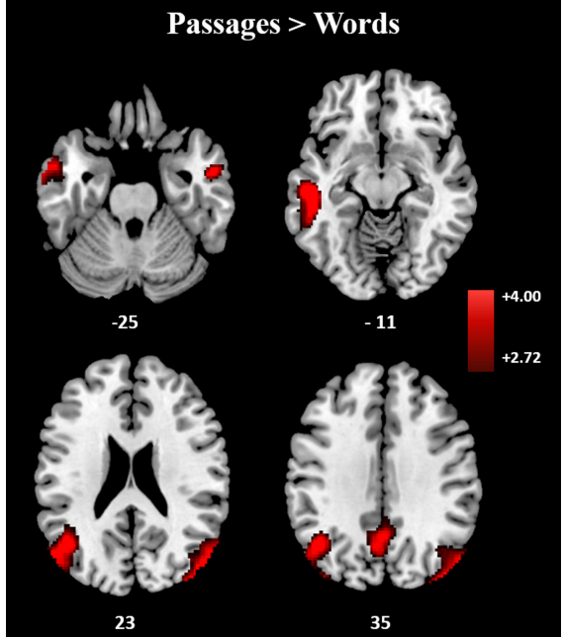
Reading
Reading = Word-level + Discourse-level processing
Question: How do these two processes interact?
FMRI reveals DL-Processing network and WL-Processing network overlap
DL-Processing involves activity in unique regions (not focusing on regions)

Slide 3
Terminology
Functional connectivity = measure of how activity in two brain regions correlate over time (does there exist a statistical relationship between recorded activity of two brain regions?)
Warning: Does explain why they correlate together (where does rel. Come from?)
BOLD Signal = Blood oxygen level dependent signal (fMRI)
Neuron does not contain reserves of energy, when activitated, blood is supplied to that cell
Changes properties of the blood (oxyhemoglobin - dexoyhemoglobin) which can be detected using a magnetic field

Slide 4
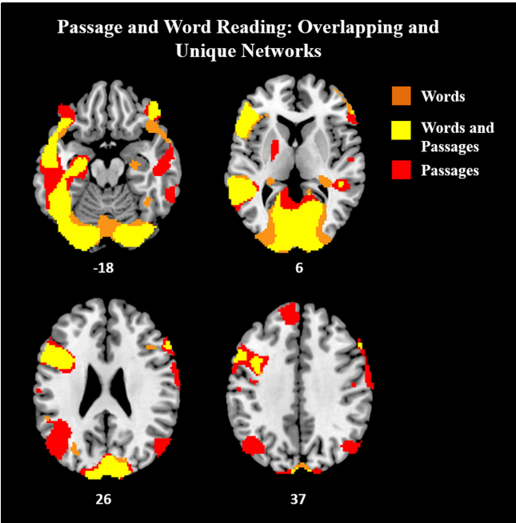
Common Hubs for WL / DL Processing

Slide 5
